Slide 1

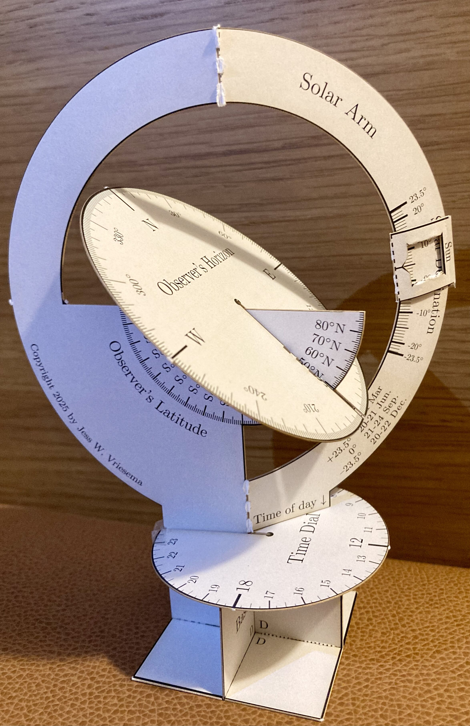
The Solar Motion Simulator: An Update to the Solar Motion Demonstrator
Jess W. Vriesema (he/him)
Calvin University
AAS 247 — #431.08
8 January 2025
QR code link to resources (incl. slides) at the end.

Slide 2
Motivation
Up/Zenith/Sky
Sun
(Highest at noon JUNE!)
North/Up
(also sky)
Sun
(South, usually)
(Highest at noon)
Diagrams can be hard.
Geometry can be hard.
Multiple terms can be hard.
Learning multiple concepts at once can be hard.
Busy/confusing figures can be hard.
Figures that have overlap with other figures can be confusing and hard.
Celestial Sphere ☺
Sun (another month)
Another ecliptic
SUN (maybe in celestial sphere)**
“Real”
North
“Real”
South
Ecliptic/equator
(Great circle)
A (not-great) circle
Sun (tonight)
(maybe in the sky???)
South/Down
(Australia’s sky?)
Nadir/down/
not sky*
* Unless you dig through the ground to China; then it points to the sky again
** (Possibly just the instructor’s messy drawings??)
Notes:
(In this slide, I’m using hyperbole to show possible sources of student confusion with common textbook diagrams.)
These diagrams often
Start with a celestial sphere
Add the celestial poles, then rotate them
Add a horizon
Show north, south, zenith and nadir
Add the ecliptic
Add the Sun
Add other ecliptics for other times of the year
Add the Sun at night
New drawing: add the sun infinitely to the right

Slide 3
Learning Outcomes
I want my students to understand…
…how the Sun moves across the sky each day
…how the Sun’s daily path changes throughout the year
…how the Sun’s path depends on the observer’s latitude
...how someone in the opposite hemisphere would see the Sun differently
…why days are shorter in winter and longer in summer
…how Earth’s tilt drives Earth’s seasons (2 ways)
…the limits of this model (local mean solar time; time zones)
I want them to have fun, too!

Slide 4
Teaching Strategies
I want students to develop a working, physical model they can make predictions with.
I want to boost student attention by using an unexpected classroom activity.
I want to give students a complementary learning approach compared to seeing pictures in a textbook.
I want to use a multisensory activity to increase student memory/retention.
I want my students to engage the material through inquiry-based learning.
I want my students to leave my classroom with curious-looking swag that their peers will ask them about.
I want my students to learn by explaining concepts to friends/family.

Slide 5
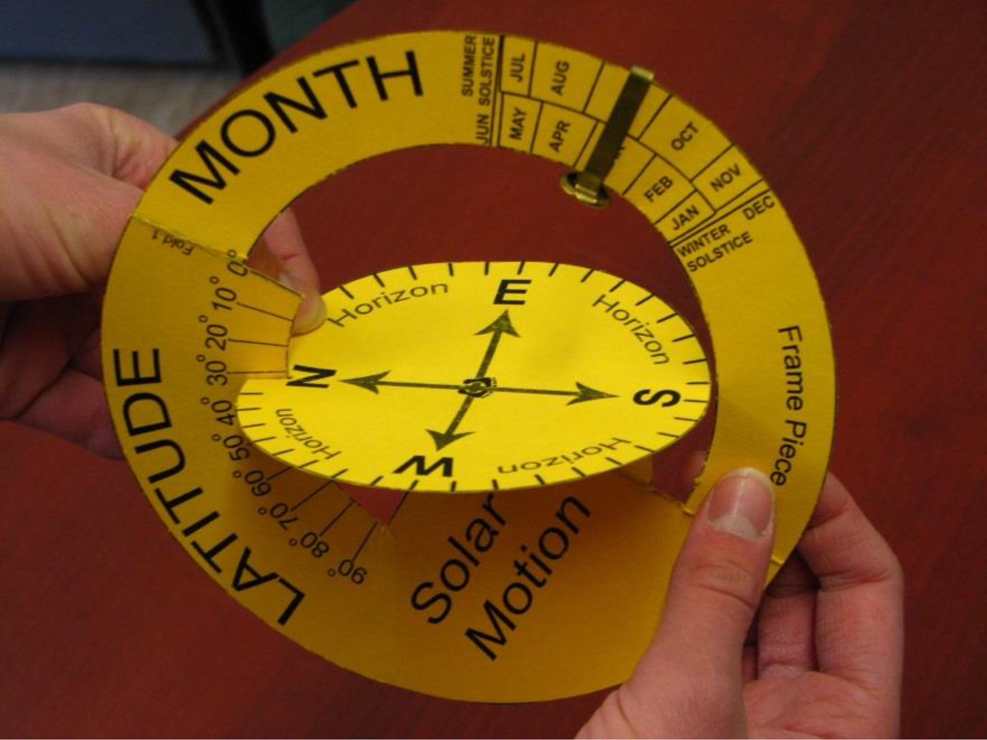
The Original Solar Motion Demonstrator (SMD)
Developed by Joseph L. Snider (Oberlin College) c. 1992
What can the user adjust?
Observer’s latitude (swivel horizon)
Time of day (move arm)
Date (slide brass fastener along arm)
Image: National Science Teachers Association
AAS 247 — #431.08

Slide 6
The Original Solar Motion Demonstrator
What does it demonstrate?
The Sun’s daily path through the sky
How the Sun’s path changes with date (solar declination)
How the Sun’s path changes with northern latitude
Causes of the seasons
Polar day/night
Image: National Science Teachers Association
AAS 247 — #431.08

Slide 7
The Original Solar Motion Demonstrator
Advantages
Cheap to produce
Simple to construct
Several classroom resources developed since 1992
Disadvantages
Requires brass fasteners
Harder to find in recent years
Sometimes slips
Only works for northern latitudes
No markings for the passage of time
Requires two hands to hold
Cannot make quantitative predictions
AAS 247 — #431.08

Slide 8
My interest…
1999–2000: I used the Solar Motion Demonstrator in a middle school class.
It was intuitive and a powerful model!
2005: I built a wooden version to simulate a sundial for my final project in my first astronomy class
It didn’t work as intended, but it worked well enough to get an A?
AAS 247 — #431.08

Slide 9
My interest…
2021: Adjunct instructor teaching my first astronomy course
I hated how textbooks diagrams of solar motions on the celestial sphere
I spent days looking for the paper model I used in middle school
Nothing!
“If it’s that hard to find, then maybe I should make my own….”
Based it on a foggy middle-school memory….
Generated it using LaTeX and TikZ
AAS 247 — #431.08

Slide 10
The (New) Solar Motion Simulator
New Features
Freestanding base
Works for all latitudes
Time of day indicator
Markings to aid assembly
Stencil files for a cutting machine
QR code to its GitHub repository
Creative Commons license
“Sun” comes with the model

Slide 11
The (New) Solar Motion Simulator
Materials Needed
Cardstock to print on
Tape
Scissors
Optional: cutting machine
Cricut/Silhouette/Siser? Laser cutter?
Assembly
Brief step-by-step instructions included with each model
Markings to aid assembly
Where to fold
Where to cut
Where to attach things
QR code to GitHub for more detailed instructions
AAS 247 — #431.08

Slide 12

The (New) Solar Motion Simulator
Design Features
Registration marks in the corners
Helps the print shop worker to align the front/back sides
More detailed latitude and solar declination tracks
Allows for more quantitative estimation
Assembly and usage instructions included with each model
Reduces assembly and activity bottlenecks
AAS 247 — #431.08

Slide 13
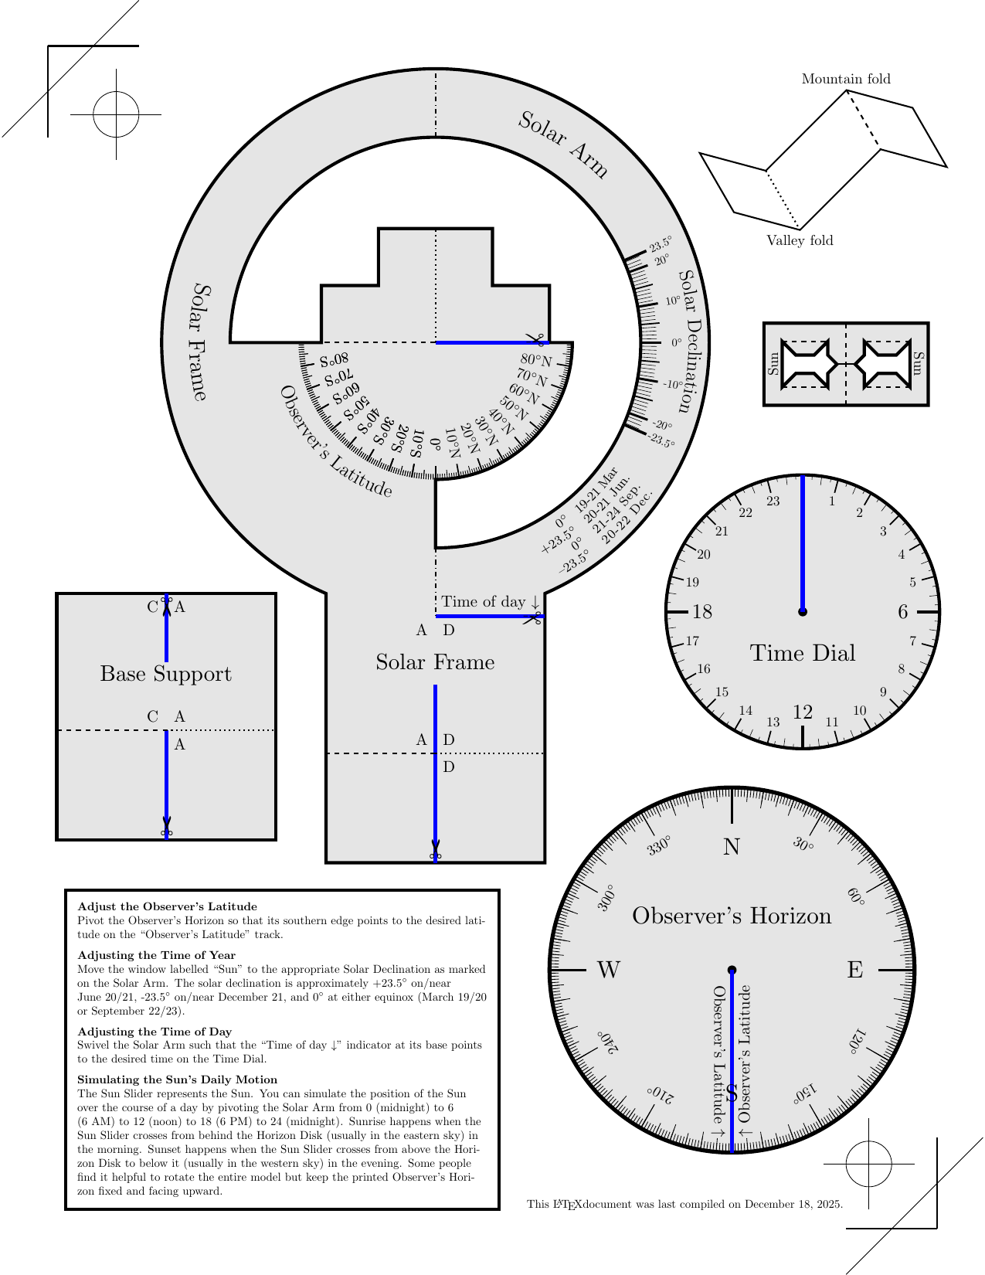
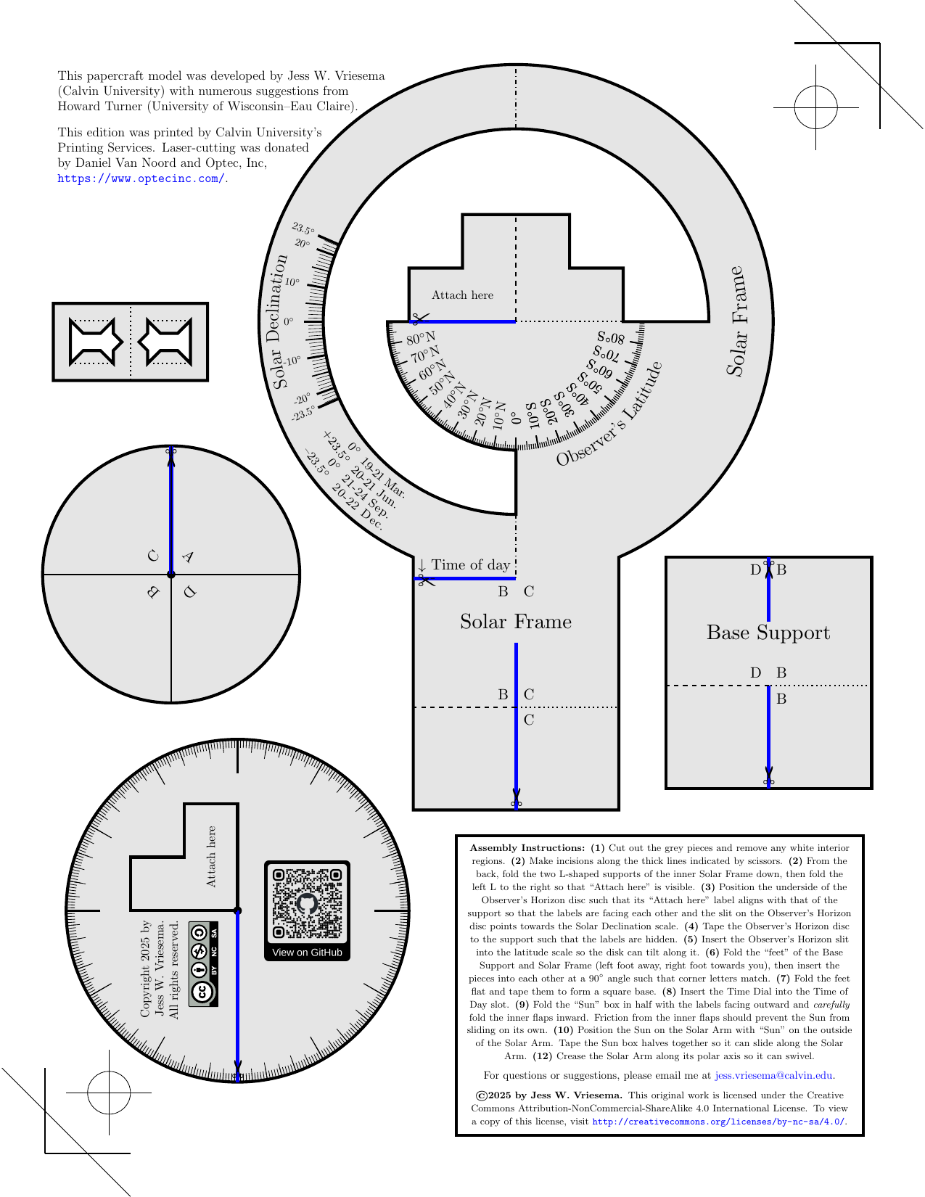
The (New) Solar Motion Simulator
Front Side
Back Side

Slide 14
Registration marks help the printer align the front and back sides.
Front Side
Back Side
LaTeX backend ensures perfect alignment between front and back PDF pages.
Any physical misalignment is due to printing errors.

Slide 15
Instruction cards tell how to assemble and how to use the model.
Front Side
Back Side
Assembly instructions
Usage
instructions

Slide 16
Scissor marks and thick, blue lines indicate where to cut incisions.
Front Side
Back Side

Slide 17
Dotted/dashed lines indicate where and how to fold.
Front Side
Back Side
Mountain folds
(crease is towards you)
- - - - dashed lines - - - -
Valley folds
(crease is away from you)
........dotted lines........
Bi-directional folds
(fold both ways)
-.-.-.-Mixed lines -.-.-.-

Slide 18
Indicators show student where to attach the horizon disk to the frame.
Front Side
Back Side

Slide 19
Arrows and divots indicate key values along various tracks.
Front Side
Back Side
Observer’s Latitude
Time of Day
Solar Declination

Slide 20
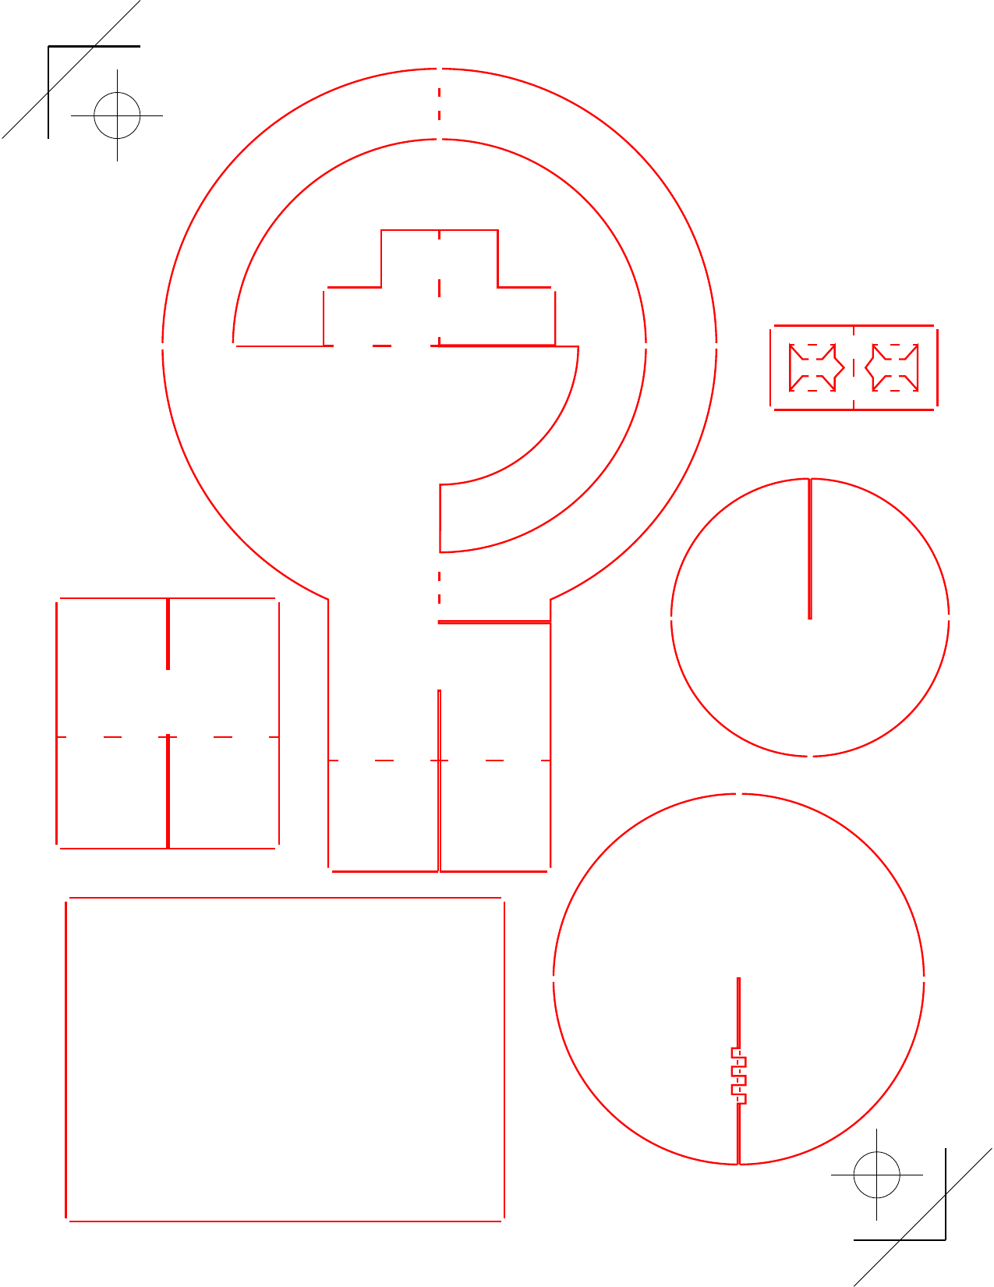
Cutting machine stencil included for fast assembly / bulk cutting
Front Side
Cutting Machine Stencil
Requires some setup time at first, but saves lots of time in class!
Excellent for large groups.

Slide 21
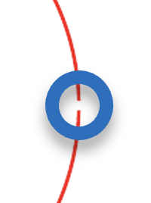
Ties hold pieces in place after cutting for straightforward distribution.
Front Side
Cutting Machine Stencil

Slide 22
Perforations along fold lines ensure easy and perfect folds.
Front Side
Cutting Machine Stencil

Slide 23
Grippers provide friction to reduce part slippage while freestanding.
Front Side
Cutting Machine Stencil
Flaps tuck into the “Sun” to hold it in place on the Solar Declination track.
Teeth hold the horizon disk in place along the Observer’s Latitude track.

Slide 24
The (New) Solar Motion Simulator
Disadvantages
More complicated to construct than the (original) Solar Motion Demonstrator
More costly to print per model
Fewer educational materials…yet
Advantages
Includes southern latitudes
Sturdy, freestanding base
Dial to show time
More detailed latitude, azimuth and solar declination tracks
Friction holds pieces in place
Instruction cards with each model
Stencils for a cutting machine
Open-source (customizable)
QR code links to more information
Costs <$1 to print (B&W)
AAS 247 — #431.08

Slide 25

QR Code → GitHub Repository
Repository contents
LaTeX source code
Printable PDF
More detailed instructions
Stencils for cutting machines (dxf, eps, svg)
License text (Creative Commons BY-NC-SA 4.0)
A sample worksheet for a college-level intro course (*.docx; edit as desired)
Try it for yourself!
AAS 247 — #431.08

Slide 26
Thank you!
Pick up a laser-cut model to bring home and show your department!
Acknowledgments
Joseph L. Snider (Oberlin College), inventor of the (original) Solar Motion Demonstrator
Turner Howard (University of Wisconsin–Eau Claire), for numerous and excellent design suggestions.
Daniel Van Noord (Optec, Inc) and Optec, Inc, for laser-cutting the models for me.
Try it for yourself!
AAS 247 — #431.08

Slide 27
Future Work
Publish instructional videos, link to them on GitHub
Assembly, usage, how to teach using the model, why it works….
Conduct a classroom intervention study
Measure its teaching efficacy and collect feedback
Create more classroom materials
Simplify and streamline assembly
Make a version for 3D printing?
AAS 247 — #431.08

Slide 28
Future Work
Remove need for tape?
Inspired by paper fasteners (no-staple staplers) and origami
Develop more and better educational materials
High school, university, public outreach?
Find industry partners (or donors?)
Precision printing
Bulk laser cutting
AAS 247 — #431.08

Slide 29
Future Work
Write Python GUI to generate customized models??
(Easier to edit/maintain the source code)
More/less detail
Large-print font
Alternate languages
With or without freestanding base
With or without friction aids (e.g. “teeth”)
Clean source code and improve documentation
AAS 247 — #431.08

